Slide 1
Peta lekcija
Šesta nedelja, Sreda
BCS Fall 2023

Slide 2
Homework for tomrrow
HW: Writing Practice Lesson 5- write 5 sentences in Cyrillic, and 5 in Latin that apply to your life using vocabulary from Textbook, Lesson 5, Pages- 26-30
+ Resubmission Dativ i Lokativ Homework

Slide 3
FILMOVI
Write down words you know

Slide 4
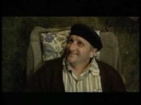
Notes:
Two years after the Bosnian war, a town that is slowly rebuilding itself must whip together a democracy when it's announced the U.S. President Bill Clinton might be paying a visit.

Slide 5
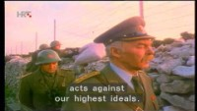
Notes:
In the beginning of 1991, the Yugoslav National Army, which does not acknowledge Croatia's independence, is still holding the military barracks throughout Croatia. Blaz Gajski travels to an island in order to retrieve his son from the barracks situated on this island. The atmosphere on the island is intense. The local government has besieged the barracks, and local people have organized a festival in front of it. With their singing and recitals, they plan to force major Aleksa and his soldiers to surrender. But, Aleksa has planted explosives in the barracks and threatens to blow up the island.

Slide 6
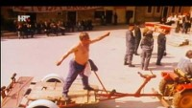
Notes:
The film centers on the Croatian island of Vis in 1998. During the funeral of a local Yugoslav Partisan veteran, his elderly comrades start seeing the ghost of Marshal Josip Broz Tito. After rumours about the apparition spread around, a Split-based policeman who goes by the name Stipan is ordered to investigate the suspicious movements of SUBNOR [sr] members in his hometown, a remote Adriatic island whose only connection with the mainland is a ferry that comes around once a week.

Slide 7
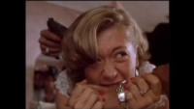

Slide 8
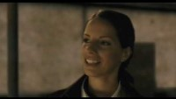
Notes:
The film is about Vlada Vasiljević, a citizen of Belgrade, who in 1979 stole a white Porsche 911 Targa S, and for about ten evenings taunted the police with his reckless driving.

Slide 9
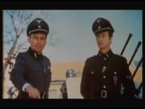
Notes:
The film centres around a mysterious figure named 'Walter', who is actively disrupting the attempts of German commander Alexander Löhr to retreat from the Balkans. The film's eponymous character, Walter, is loosely based around Vladimir Perić, whose nom de guerre was 'Valter'.

Slide 10
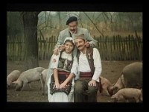
Notes:
"Petria's wreath" is a story about the tragic life of an illiterate village woman and her life with three men she loves. Torn between dreams and reality, she endures a life of suffering, loneliness, disappointment, hope, and love.

Slide 11
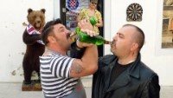
Notes:
A homophobic Serbian gangster is forced to make a deal with wedding planner gay activist, to assemble a team which will protect the upcoming Pride Parade in Belgrade, and in exchange his fiancée can get her dream wedding.

Slide 12
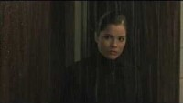
Notes:
A man awakens from a two-month-long coma with total amnesia and sets out to discover the truth about his identity.

Slide 13
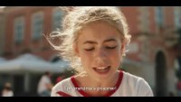
Notes:
The movie 'The Summer when I learned to fly', based on the identically-titled novel written by Jasminka Petrović, directed by Radivoje Raša Andrić, is a story of love, growing up, value of family and friendship that will take you through the halls of carefree childhood for at least a moment.

Slide 14
Lekcija 5

Slide 15
Razgovor
Activity 1: Pročitajte razgovor iz knjige
Activity 2: Miro

Slide 16
Četrvrtak

Slide 17

Sara Renar- Jesen
Handout
English translation https://lyricstranslate.com/en/jesen-autumn.html-0

Slide 18
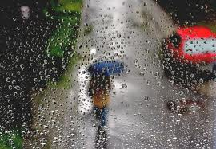
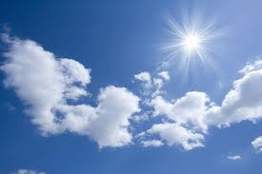
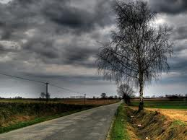
Vreme/vrijeme je …
kišovito
sunčano
oblačno

Slide 19
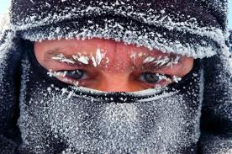
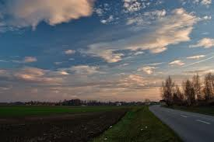
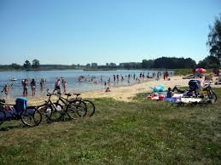
Danas je…
hladno (cold)
toplo (warm)
vruće (hot)

Slide 20
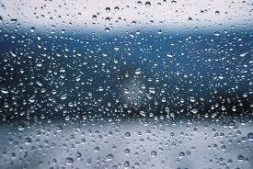
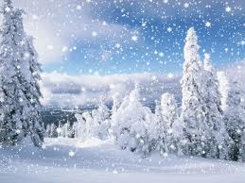
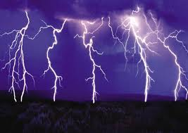
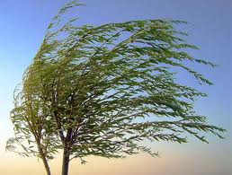
Vremenski uslovi/uvjeti(C) –weather conditions
Pada kiša
Pada sneg/snijeg
Grmi
Duva vetar/puše vjetar
Sunce sija

Slide 21
Temperatura
Like the rest of the world, BCS uses Celsius
Here’s a rhyme to help interpret temperatures
30 is hot, 20 is nice
10 is cold, 0 is ice
Degree = stepen (SB)/ stupanj (C)
2,3,4 stepena/stupnja; 5-20 stepeni/stupnjeva
‘plus X stepena (i)/stupnja (stupnjeva) = X degrees above zero
‘minus X stepena (i) )/stupnja (stupnjeva) = x degrees below zero

Slide 22

Godišnja doba/seasons
Zima/winter
Zimi (in the winter)
Proleće/proljeće/spring
Na proleće/ proljeće (in the spring)
Leto/ljeto/summer
Leti/ljeti (in the summer)
Jesen/fall
Na jesen (in the Fall)

Slide 23
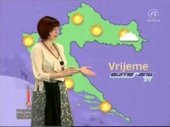

Slide 24
Imati/nemati/moći

Slide 25
Verb hteti/htjeti -to want
This verb has irregular conjugation and must be memorized!
Ja hoću Mi hoćemo
Ti hoćeš Vi hoćete
On,Ona, Ono hoće Oni, one ona hoće
Note 3.p.sg and 3,p.pl are the same!!!

Slide 26
Negative form of “to want”
Ja neću Mi nećemo
Ti nečeš Vi nećete
On, Ona, Ono neće Oni, One, Ona neće
Translates as I don’t want to, you don’t want to, etc.

Slide 27
Verb moći -to be able to
This verb has irregular conjugation and must be memorized!
Ja mogu Mi možemo
Ti možeš Vi možete
On, Ona, Ono može Oni,One,Ona mogu
Note: 1.p.sg and 3.p.pl are the same!!!

Slide 28
Important exceptions
To have
Verb not to have:
Ja nemam
Ti nemaš
On, Ona, Ono nema
Vi nemate
Mi nemamo
Oni, One, Ona nemaju
Note: to have- imati
Not to have- nemati (spelled as one word!!!)
Ja imam
Ti imaš
On/ona/ono ima
Mi imamo
Vi imate
Oni/one/ona imaju

Slide 29
2 ways of expressing present tense
Da + present tense
Present + infinitive
Idem da plivam. I am going to swim.
Volimo da pevamo/pjevamo.
We like to sing.
Ja ne volim da čitam.
I don’t like to read.
This is more Serbian but not stricktly Serbian!!!
Idem plivati.
Volimo pevati/pjevati.
Ne volim čitati.
This type is more Bosnian and Croatian but not strictly Bosnian and Croatian.

Slide 30
Grammer review
Person | Moći | Negative Moći | Hteti | Negative Hteti | Imati | Nemati
Ja | mogu | Ne mogu | hoću | neću | imam | nemam
Ti |  |  | hoćeš |  | imaš
On/ona/ono | može | Ne može |  | neće | ima | nema
Mi |  |  | hoćemo | nećemo |  | nemamo
Vi | Možete | Ne možete | hoćete |  | imate
Oni/one/ona | Mogu | Ne mogu |  | neće |  | nemaju

Slide 31
Grammer review
Person | Moći | Negative Moći | Hteti | Negative Hteti | Imati | Nemati
Ja | mogu | Ne mogu | hoću | neću | imam | nemam
Ti | možeš | Ne možeš | hoćeš | nećeš | imaš | nemaš
On/ona/ono | može | Ne može | hoće | neće | ima | nema
Mi | Možemo | Ne možemo | hoćemo | nećemo | imamo | nemamo
Vi | Možete | Ne možete | hoćete | nećete | imate | nemate
Oni/one/ona | Mogu | Ne mogu | hoće | neće | imaju | nemaju

Slide 32
Present Tense Endings
učiti i-e type
pevati/pjevati a/ju
pisati e/u type
uč___
uč___
uč ___
uč ___
uč ___
uč ___
Pev_____
Pev _____
pev _____
pev _____
pev _____
pev _____
piš _____
piš _____
piš _____
piš _____
piš _____
piš _____

Slide 33
Endings
učiti i-e type
pevati/pjevati a/ju
pisati e/u type
učim
učiš
uči
Učimo
učite
uče
Pevam
Pevaš
Peva
pevamo
Pevate
pevaju
pišem
pišeš
Piše
pišemo
pišete
pišu

Slide 34
Fill in the correct present tense forms
Ja (čitati) pismo. a/ju
Mi (spremati) ispite. a/ju
Cveće/cvijeće (cvetati/ cvjetati). a/ju
Studenti (ići) na čas/sat. e/u
Mi (pisati) sastav. e/u
Vi (imati) nov auto. a/ju
Ja čitam pismo.
Mi spremamo ispite.
Cveće/ cvijeće cveta/ cvjeta.
Studenti idu na čas/sat.
Mi pišemo sastav.
Vi imate nov auto.

Slide 35
Ti (nemati) kaput. a/ju
Oni (hteti/htjeti) vodu.
Oni (ne hteti/htjeti) vodu
Ona (šetati se) kroz park. a/ju
Vi (ne govoriti) engleski. i/e
Ti (ne voleti/ne voljeti da radiš). i/e
Ti nemaš kaput.
Oni hoće vodu.
Oni neće vodu.
Ona se šeta kroz park.
Vi ne govorite engleski.
Ti ne voliš da radiš.

Slide 36
Fill in the appropriate personal pronoun and assign the present tense type
... učiš.
...rade.
...piše.
… spremaju ispite.
igrate fudbal/nogomet.
… ide na univerzitet /sveučilište.
… izlaze često.
Ti (i/e)
Oni/one/ona (i/e)
On/ona/ono (e/u)
Oni/one/ona (a/ju)
Vi (a/ju)
On/ona/ono (e/u)
Oni/One/Ona (i/e)

Slide 37
Reading practice
Stiv Bond je Englez. On je sada u Beogradu. On radi u firmi «Praktikum». To je engleska firma. Stiv radi u Beogradu i uči srpski jezik. On uči jezik u školi svakog jutra. Svakog dana, Stiv mnogo radi. Teško je raditi i učiti jezik. Stiv ne uči jezik samo u školi. On čita novine i sluša radio. On govori srpski u firmi. Stiv sluša radio u automobilu, svakog jutra. Čita engleske i srpske novine. Ne razume sve, ali razume mnogo. Svako veče Stiv gleda televizor. Teško je razumeti svaki program ali je interesantno gledati. Stiv ne govori dobro srpski ali mnogo razume.

Slide 38
Activities
Activity 1: highlight all the words you don’t know in yellow
Activity 2: Answer questions:
Šta radi Stiv Bond?
Gde Stiv uči srpski?
Koji jezik govori Stiv?
Gde Stiv sluša radio?
Koje novine čita Stiv?
Activity 3: Highlight all verbs in green and find their infinitive form
Activity 4: Determine the cases of the underlined words

Slide 39
Reading practice part 2
Jovan: Šta radiš? Stiv: Čitam novine. Jovan: Da li čitaš engleske ili srpske novine? Stiv: Sada čitam engleske novine, ali svakog jutra čitam i srpske novine. Jovan: Da li dobro razumeš? Stiv: Razumem, ali ne sve. Jovan: Da li je teško razumeti radio program? Stiv: Da, čitati nije teško, ali je teško slušati. Jovan: Da li gledaš televizor? Stiv: Da, svako veče. Ne razumem sve, ali je interesantno gledati. Jovan: Dobro govoriš srpski! Stiv: Hvala!

Slide 40
Odgovorite na pitanja
1. Da li učite srpski/hrvatski/bosanski? 2. Gde učite srpski/hrvatski/bosanski? 3. Da li govorite srpski/hrvatski/bosanski? 4. Koji jezik govorite? 5. Da li čitate novine? 6. Da li slušate radio?
7. Da li gledate televizor?

Slide 41
Homework
Present tense Part 2 (Moodle)
Instrumental Resubmission

Slide 42
Flip (Due Sep 29 + questions (sat) + answers (sun)
The goal of this oral practice is to be able to describe the weather.
Step 1: Choose a city/town/village in the ex-Yu region and briefly describe it (refer to example). Step 2: Tell us about the weather there during different seasons.
Step 3: Tell us how the weather is there now.
Be free to add any relevant information about that place.
Example: Danas želim da vam opišem vreme u Kruševcu. Kruševac je u centralnoj Srbiji, između Beograd i Niša. Jesen u Kruševcu je kišovit, ali topao. Zima nije strašna, nema puno snega. Proleće je kišovito, ali ima sunčanih i toplih dana. Leto je vruće, ali prijatno. Danas je u Kruševcu oblačno ali toplo.
Pitanja?

